Slide 1

Mind Matrix Analytics
Customer Retention Case Study

Slide 2

Problem Description
THE Bank wants to employ various strategies this quarter to retain the customer pool and prevent from churning.
They have approached Mind Matrix Analytics (MMA), a consultant group to study their current strategies and identify challenges in achieving their goal.
The bank wants to know:
Which variables are significant in predicting the customer's duration with the bank?
How well those variables describe the customer's duration with the bank?
Based on data, the consulting firm has to look at how well the bank is performing with their different customer segments.

Slide 3
Business Objective understanding and High-level Approach
Business problem
Identifying improvement areas for the client (THE Bank) in order to come up with strategies to retain customers.
Data understanding
Structured data containing client's customers' details with following columns [Gender, Age, Income, Segment, Financial activity, Products interested in, Duration], total records of 54030.
Key factor to be considered
Customer details that show six month's activity status and total duration for which they have remained the client's (bank's) customer.
Objective: We at MMA would have to analyse and suggest what are the potential features that might require attention to ensure the customers are retained to our client.

Slide 4
Data Health Review
Variable Check
Missing Values and Outliers
Data Cleaning
Data has 4 variables which are numeric in nature and 6 variables which are categorical.
All the numerical values are in the right format.
Total number of rows - 54030.
No missing values in dataset.
Outliers in age (2 to 112) and gross income (2,336 to 7,089,412).
Assumption: Number of credit cards, number of loans, Active_Inactive_end have only two values, 0 and 1. Assuming that these are categorical Values, we will be converting them into String.
Identifying duplicates and elementating them. Yes, Found ~ 1190.
Extra spaces eleminated.
EDD - Adding Years column by converting duration from days to number of years.
Data is Good to GO.

Slide 5
Extended Data Dictionary
Variables | Variable Type | Description | Data Type
gender | Categorical | Gender of Customer | String
age | Numerical | Age of Customer | Integer
gross_income | Numerical | Annual income | Float
segment | Categorical | Segment as specified by the bank | String
num_credit_cards | Categorical | Number of credit cards issued | String
active_inactive_start | Categorical | Customer Inactivity Flag at the beginning of the period (A-Active, I-Inactive) | String
active_inactive_end | Categorical | Customer Inactivity Flag at the end of the period (6 Months) (1-Active, 0-Inactive) | String
num_products | Numerical | Total number of financial products that the customer has bought | Integer
num_loans | Categorical | Total number loans disbursed to the customer | String
duration | Numerical | Number of days since customer | Integer
duration_years | Numerical | Number of years since customer. | Float

Slide 6

Exploratory Data Analysis
Quality check of data
Missing data
Derivative features
Removing duplicates from dataset
Subsets of data
Univariate Analysis
Bi-variate Analysis
Outlier Analysis
Correlation Analysis
Customer, Segment, Product Analysis

Slide 7
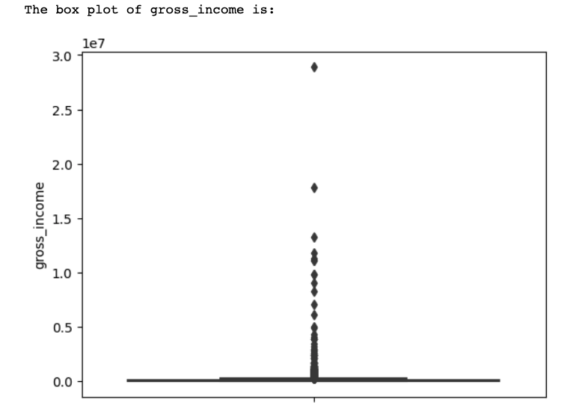
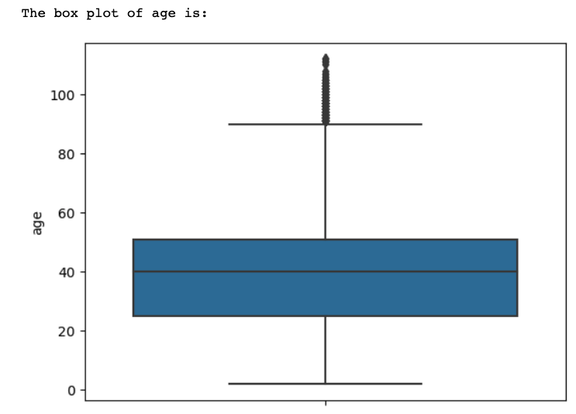
Outliers

Slide 8

KPI / Metric Based Questions
These questions have a specific ask (pin-pointed) and getting to the required outcome is quite straightforward.
We used Excel and Python to arrive at these answers.

Slide 9
1. What % of customers were active before and after the 6 months period?

Slide 10
2. Count of customers based on Activity Status

Slide 11
3. Comparative Metrics for the Customer Activity Status
Customers who remained active | Active customers who became inactive | Inactive customers who became active | Customers who remained inactive
A-A | A-I | I-A | I-I

Slide 12
4. Comparative Metrics for Female and Male customers

Slide 13
4. Continued.....

Slide 14
5. Comparative Metrics – Customer Segments (College, Individual,…)

Slide 16
6. Percentage of Customer Segments Activity

Slide 17
Open-ended Questions
For the first 5 questions performed chi square test as the variables are categorical to categorical(numerical)
Q1. In future which of the customer segments (college, individual, VIP) can be expected to remain active compared to others?
ANS: VIP can be expected to remain active(17.9%)
Q2. In future which of the customer segments (college, individual, VIP) can be expected to remain inactive compared to others?
ANS: Individuals can be expected to remain inactive(97.4%)
Q3. In future, which of the customer segments (college, individual, VIP) can be expected to become inactive compared to others?
ANS: Individuals can be expected to become inactive(97.4%)

Slide 18
Q4 Which of Male/Female customers are more stable and do not change their activity/inactivity level much?
ANS: By observing the above values, there is slightly less variation (0.24) in activity status of male customers compared to female customers (0.25). However there is no statistically significant change in stability of activity status by gender.
Q5 Which of Male/Female customers are more volatile and change their activity/inactivity level?
ANS: By observing the above values, there is slightly more variation (0.25) in activity status of female customers compared to male customers (0.24). However there is no statistically significant change in stability/volatility of activity status by gender.

Slide 19
For questions 6,7,8 performed t-test as variables are categorical and numerical.
Q6. What impact does Income have on customer activity/ inactivity?
ANS: gross_income has less impact on the customer activity status statistically.
Q7. What impact does Age have on customer activity/ inactivity?
ANS: age does not impact customer activity status.
Q8. What impact does Duration has on customer activity/ inactivity?
ANS: As the p-value is zero there is no significant impact of duration on the customer activity status.

Slide 20
Strategies and Recommendations
1. Target customers based on segments with age group and income in consideration.
2. Target specific products like loans, credit cards based on age group and income.

Slide 21

Based on income
1. More than 287k: Less products were purchased. Place more strategies to attract use of the bank's products
2. Initiate better loans for income of less than 287k

Slide 22
Based on Credit cards/Loans
1. 5% customers only use credit cards- Individuals make up for most of the card holders. So target College grads and VIPs with specific offers to utilize the under-represented potential market
2. Age groups of 41-53 among individuals and 45-58 in VIPs are utilizing credit cards. Provide offers that would cater to their age groups through collaborations with insurance packages
3. Individuals segment shows a higher demand/ use of loans- The Bank could look into credit card and loan benefits

Slide 23

Conclusion
Most of the features/attributes in the data reveal that they do not show a statistically significant relation with the activity status of the customers. MMA would require more data to interpret and devise statistically sound strategies and /or ML models to predict better recommendations to retain customers.

Slide 24

Q & A

